Slide 1
Air-BnB Recommendation System
Group 7
Wong Xin Pei
Candy Lim
Tan Jun Xian

Slide 2
Agenda
Objective
Data
Algorithms
Evaluation
Conclusion
What do want to accomplish?
Exploration
Pre-Processing
Word Embeddings / Vectorization
Visualization of results
Recommend user’s preferred Airbnb with the most accuracy as possible.
PCA + TensorBoard
TF-IDF
Doc2Vec
Cosine-Similarity
K-NN
Cosine-Similarity

Slide 3
Objective
Name | Description | Availability
User
Input

Slide 4
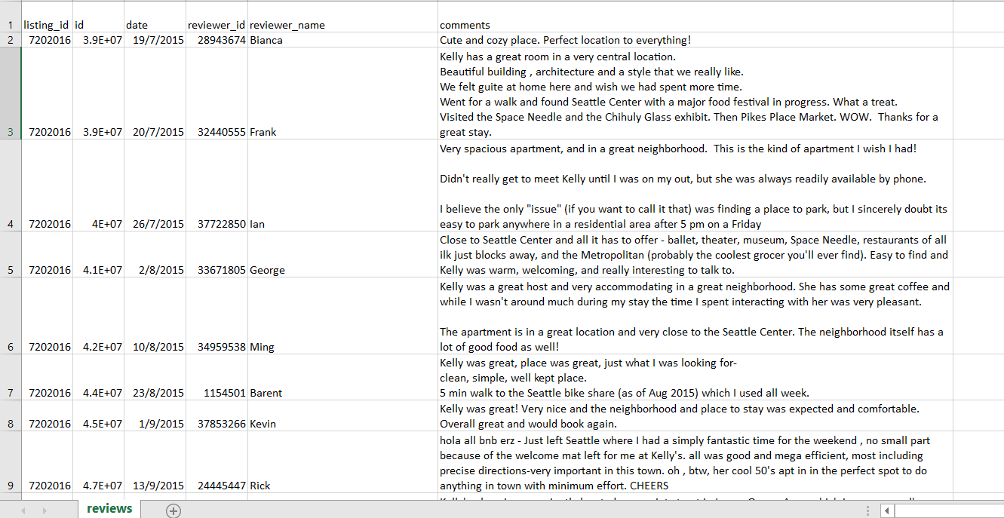
Data
In the dataset, there exists written reviews of the Airbnb. We decided to use these text data to aid in recommending the user what they want.
Displaying map location of airbnb.
Calculating positive of negative score.
Additional
We also decided to include simple filters for the dataset we have, where users can just select what attributes they want their room to have. E.g Number of beds
Text
Raw filters

Slide 5
Word Embeddings/Vectorization
Vector representations (numbers) of a word
Process huge text data
For Machine Learning algorithms
User Input
I want big rooms
X1
House has big rooms
 | I | Want | Big | Rooms | House | has | many | small
User Input | 1 | 1 | 1 | 1 | 0 | 0 | 0 | 0
X1 | 0 | 0 | 1 | 1 | 1 | 1 | 0 | 0
X2 | 0 | 0 | 0 | 1 | 0 | 0 | 1 | 1
X2
Many small rooms

Slide 6
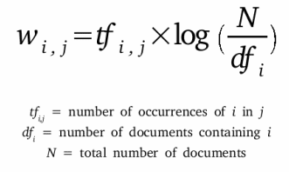
TF-IDF
Term Frequency - Inverse Document Frequency
term = word
Number of times a term (t) appeared in a doc (d)
Total number of docs (d)
*
Total number of docs (n)
Number of documents with the term (t) + 1
Log
Process of giving a word a numeric value (w)
Determines how important the word is, in the document

Slide 7
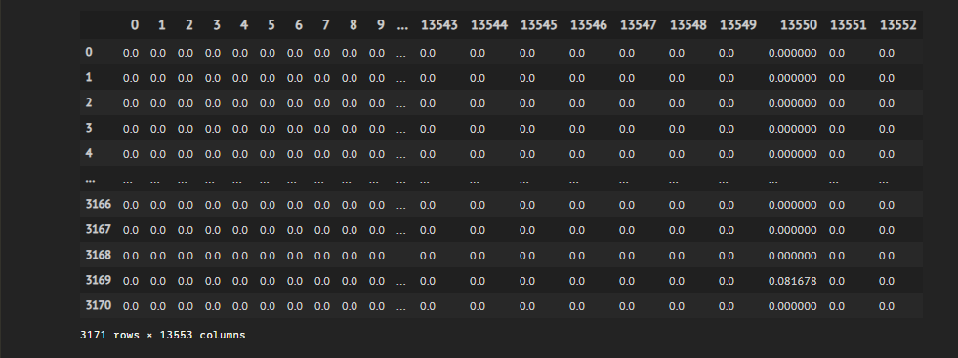

Slide 8
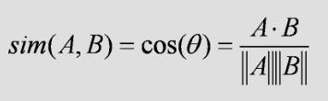
Cosine-Similarity
Determine how similar words/documents are regardless of magnitude
Where A and B are vector representations of words/documents
Since angle is small,
Similarity value will be high
Exactly same,
Similarity value will be 1
Similarity value will be 0
A
A
A
A
B
B

Slide 9
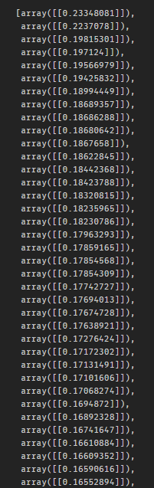
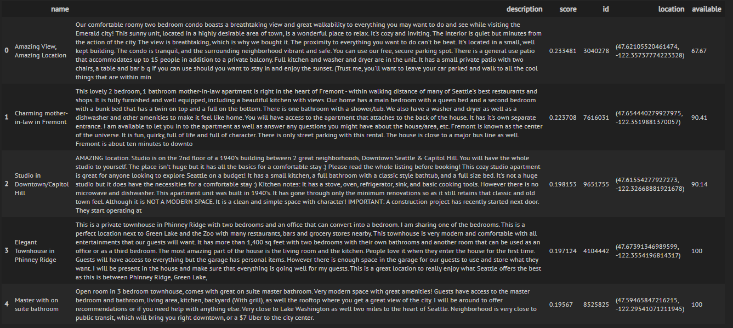

Slide 11
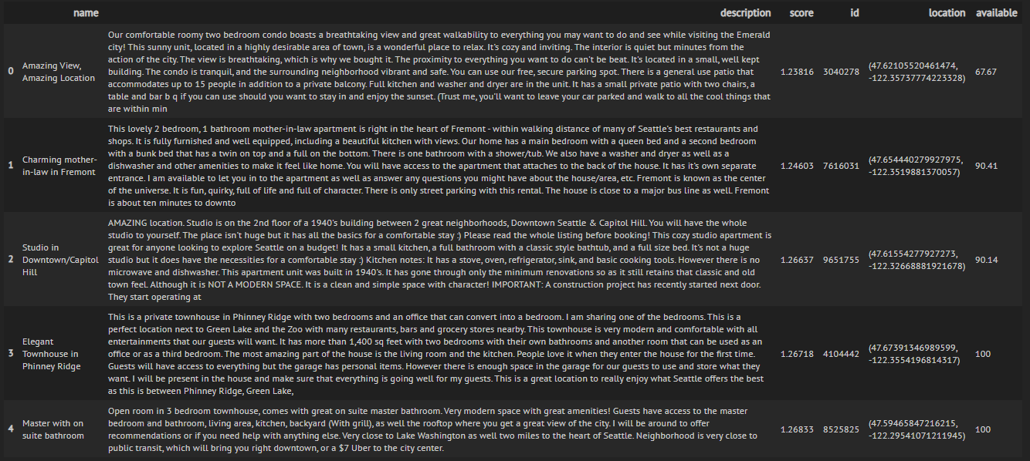
K-NN
Since we know our documents/listings are vectors
Points on graph
Find Nearest Neighbors of “User-Input point” -> Using Euclidean

Slide 12
Doc2Vec

Slide 15
Evaluation
TF-IDF
Doc2Vec

Slide 16
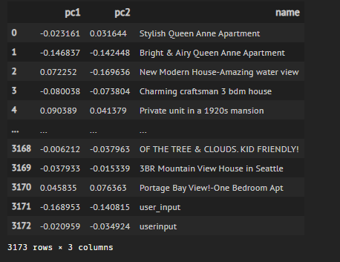
PCA
Principal Component Analysis
Dimensionality Reduction Process
Thousands of features/dimensions
2 dimension

Slide 17
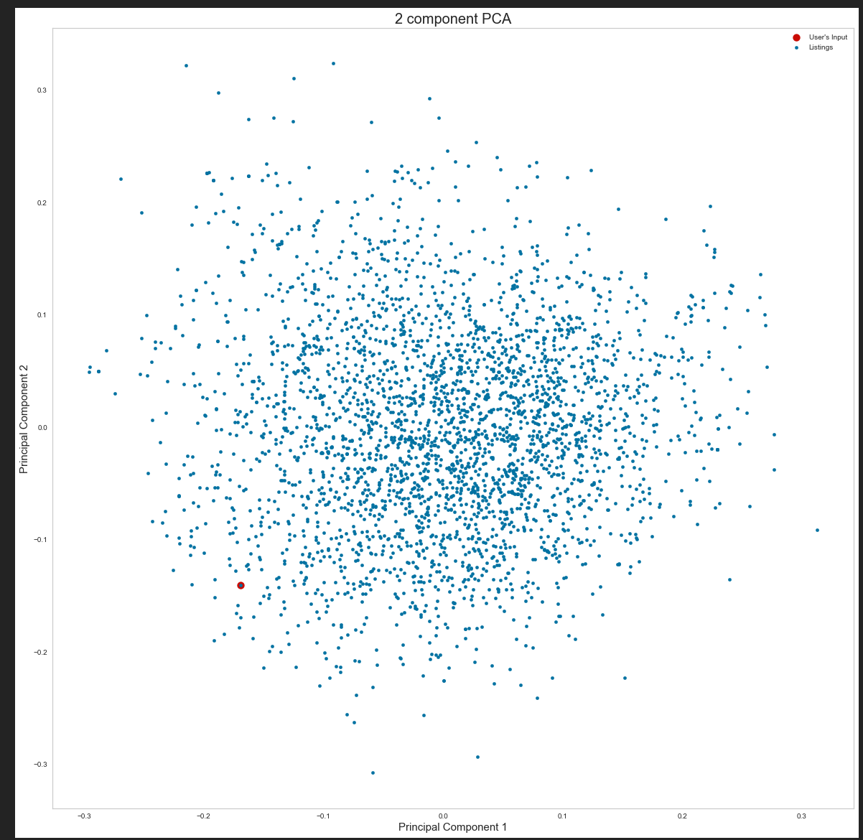
Scatter Plot of the Listings with User’s Input

Slide 18
Tensorboard Embedding Projector

Slide 22
Map location of the Airbnb
System will allow to view listings on google map.

Slide 23
Conclusion
GUI system
K-nn (Nearest Neighbour)
TF-IDF
Doc2Vec
Cosine-Similarity
Filters
Maps

Slide 24
End
Thank you and have a nice day ahead!

